Slide 1

Zimele Unit Trust Scheme 17th AGM
Fund Manager’s Presentation

Slide 2
Zimele Unit Trust Funds 17th Annual General Meeting
About Us
Who we are
Zimele Asset Management provides fund management services for unit trusts and pension schemes, and has been in operation since 1998.
Our Licenses
Fund Manager for the Zimele Unit Trust Scheme, licensed and regulated by the Capital Markets Authority “CMA”
Fund Manager for the Zimele Pension Schemes, licensed by the Retirement benefits Authority “RBA”

Slide 3
Zimele Unit Trust Funds 17th Annual General Meeting
Collective Investment Schemes Managed
Zimele Unit Trust Scheme
Zimele Fixed Income Fund
Zimele Balanced Fund
Zimele Money Market Fund
Zimele Personal Pension Schemes
Zimele Guaranteed Personal Pension Scheme
Zimele Personal Pension Scheme
Zimele Income Drawdown Plan

Slide 4
Zimele Unit Trust Funds 17th Annual General Meeting
Duties of the Fund Manager
To invest unit holders’ funds in accordance with the Collective Investment Schemes (CIS) Regulations 2023, the trust deed and the Fund’s Investment policy
To receive and implement unit-holders’ contribution, top-up, switching and liquidation instructions
To report the Fund’s investment performance to the Trustees and the Regulator
To report to the unit holders at the annual general meeting

Slide 5
Zimele Unit Trust Funds 17th Annual General Meeting
Zimele Unit Trust Funds
Fund Attributes
Zimele Fixed Income
Zimele Balanced Fund
Risk profile
Low risk
Modest returns
Instant/same day
No penalties on withdrawal
Both for deposits & withdrawals
Online statements
Monthly Interest Updates
Suitable for emergencies, discretionary and goal-based savings.
Moderate risk
Varying returns
Instant/same day
No penalties on withdrawal
Both for deposits & withdrawals
Online statements
Monthly Returns Updates
Suitable for medium-term and long-term goals due to partial exposure to the equities market
Returns
Withdrawal
Penalties
M-Pesa & Bank
Statements
Returns updates
Recommendation

Slide 6
Zimele Unit Trust Funds 17th Annual General Meeting
Economic Review
Global Highlights
Domestic Highlights
Recovery from Covid-19 plus geopolitics including Ukraine-Russia conflict and Israel-Palestine conflict
Rising inflation across the major economies
US central bank revised its policy rates gradually to 5.5% by Dec 2023
  Hope to tame inflation and anchor it at target 2%
  Caused capital flight with developing and underdeveloped countries most affected
  Strengthening of USD against other countries
Rising Inflation
Extreme drought in Q1 pushing inflation to 9.2% in March 2023
Heavy rains in Q4 2023 eased inflation to 6.6% in Dec-2023
Speculation about Kenya’s ability to repay maturing Eurobond together with capital flight resulting from high interest rates in developed economies pushed Kenya shilling to depreciate 27% by Dec 23 against USD and other currencies
CBR revised from 8.75% in Jan 23 to 12.5% by Dec 23
Domestic interest rates increased significantly

Slide 7
Zimele Unit Trust Funds 17th Annual General Meeting
Zimele Fixed Income Fund

Slide 8
Zimele Unit Trust Funds 17th Annual General Meeting
Zimele Fixed Income Fund

Slide 9
Zimele Unit Trust Funds 17th Annual General Meeting
Zimele Fixed Income Fund

Slide 10
Zimele Unit Trust Funds 17th Annual General Meeting
ZFIF – Funds under Management
The Closing Fund Under Management (FMU) 2019-2023
YEAR | 2023 | 2022 | 2021 | 2020 | 2019
Total Fund Value | 2,678,218,084 | 2,410,726,733 | 1,741,760,625 | 1,261,280,261 | 931,058,295
Price Per Unit | 1.00 | 1.00 | 1.00 | 1.00 | 1.00
Number of Units in Issue | 2,678,218,084 | 2,410,726,733 | 1,741,760,625 | 1,261,280,261 | 931,058,295
Percentage Annul Growth | 11.10% | 38.4% | 38.1% | 35.5% | 14.3%
The Closing Fund under Management (FMU) and Units in Issue over the 5 Year Period
Zimele Fixed Income continued to record a double digit growth in FUM despite a tough year characterized with emergence of new products and capital out flows.

Slide 11
Zimele Unit Trust Funds 17th Annual General Meeting
Zimele Balanced Fund Asset Allocation as at 31st December 2023

Slide 12
Zimele Unit Trust Funds 17th Annual General Meeting
Zimele Balanced Fund Periodic Returns

Slide 13
Zimele Unit Trust Funds 17th Annual General Meeting
ZBF - Historical Returns
NB: Past performance is not an indication of the future performance

Slide 14
Zimele Unit Trust Funds 17th Annual General Meeting
Zimele Balanced Fund
The Closing Fund under Management (FUM) and Units in Issue over the 5 Year Period
The Closing Funds Under Management (FUM) 2019-2023
YEAR | 2023 | 2022 | 2021 | 2020 | 2019
Total Fund Value | 188,117,558 | 179,063,467 | 184,350,166 | 173,540,158 | 168,142,390
Price Per Unit | 9.2796 | 9.4562 | 9.2634 | 8.3312 | 8.2305
Number of Units in Issue | 20,272,162 | 18,936,091 | 19,900,842 | 19,869,048 | 20,394,132

Slide 15
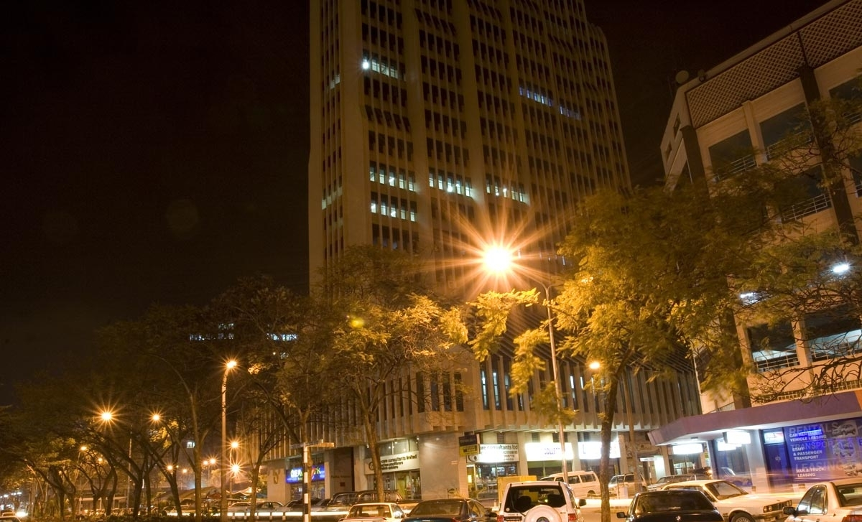

Zimele Asset Management
Company Ltd,
Ecobank Towers, 7th Floor, Wing A
Mobile: +254-722-207662
E-mail: info@zimele.net
Website: www.zimele.co.ke

