Slide 1
Shadrack
Zimele

Slide 2
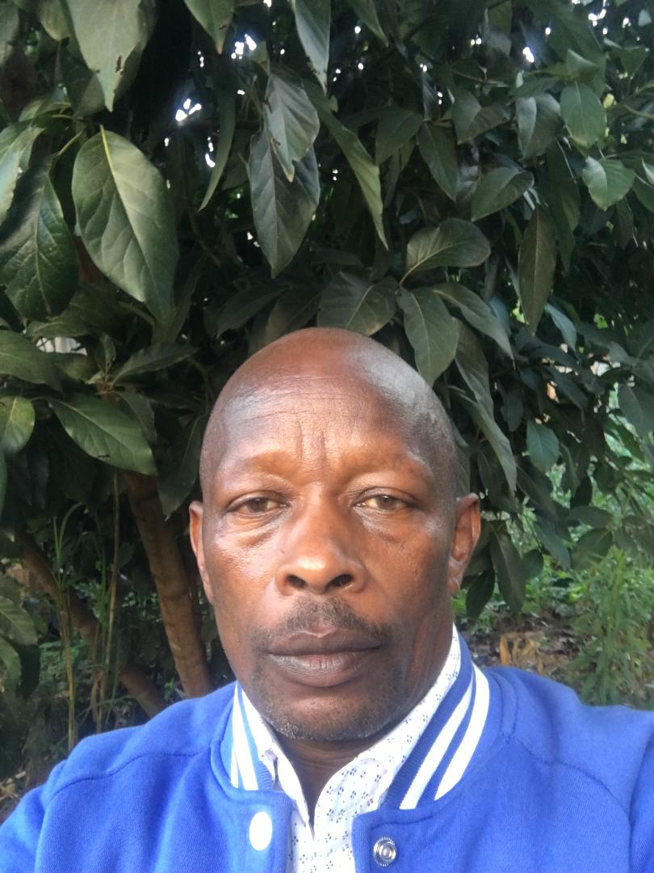

Slide 3
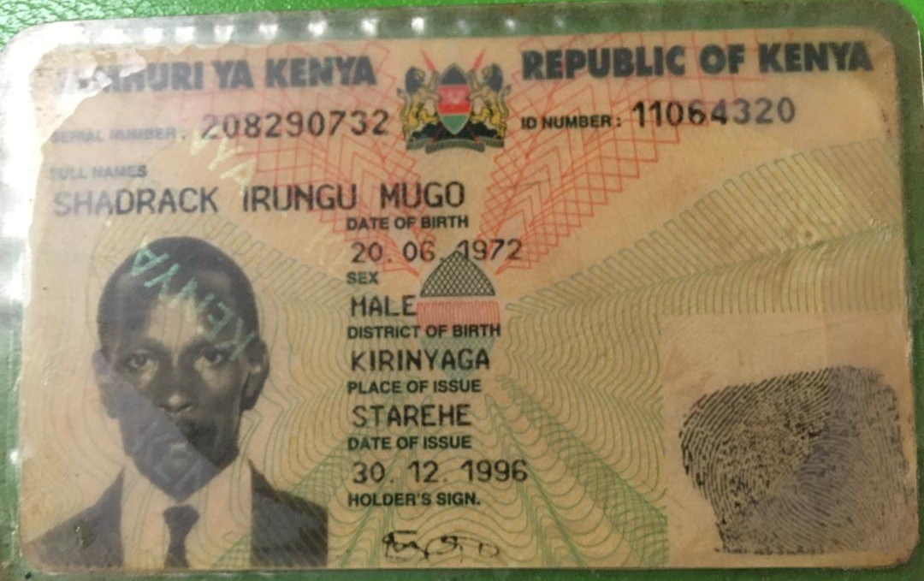

Slide 4
